Slide 1
Announcements
Parts of today review the SQL part of CS61A/CS88. Sorry if it seems a little redundant.
HW4 extended until tomorrow to encourage voting, lecture might end early as well. HW5 released today.
Project 2 will be released next Tuesday (11/13), due last day of class (11/29).
Today covers everything you’ll need in terms of SQL for proj2 (with maybe one minor exception).

Slide 2
Databases and SQL
?
Slides by:
Joseph E. Gonzalez, Joseph Hellerstein, Josh Hug
jegonzal@berkeley.edu
jhellerstein@berkeley.edu
hug@cs.berkeley.edu

Slide 3
What is a database?

Slide 4
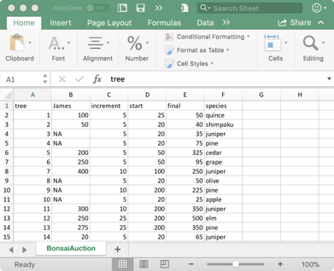
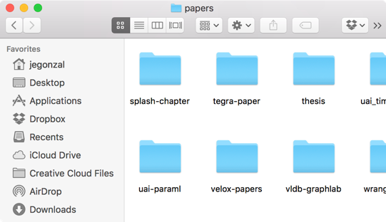
Defining Databases
A database is an organized collection of data.
A database management systems (DBMS) is a software system that stores, manages, and facilitates access to one or more databases.

Slide 5
Database Management Systems
Data storage
Provide reliable storage to survive system crashes and disk failures
Special data-structures to improve performance
Data management
Configure how data is logically organized and who has access
Ensure data consistency properties (e.g., positive bank account values)
Facilitate access
Enable efficient access to the data
Supports user defined computation (queries) over data

Slide 6
Is Pandas a Database Management System?
Data Storage?
Pandas doesn’t store data, this is managed by the filesystem
Data Management?
Pandas does support changing the organization of data but doesn’t manage who can access the data
Facilitate Access?
Pandas does support rich tools for computation over data
Pandas is not generally considered a database management system but it often interacts with DBMSs

Slide 7
Is your file-system a DBMS
Data Storage?
File systems reliable store data on your computer
Data Management?
File systems offer tools to manage access and reorganize data.
Data organization at the granularity of files … (coarse)
Facilitate Access?
Can read files but provides limited computational facilities.
The file-system is not generally considered a DBMS though it often used in place of one … (not a good idea)

Slide 8
Why should I use a DBMS?
Why can’t I just have my CSV files?
DBMSs organize many related sources of information
DBMSs enforce guarantees on the data
Can be used to prevent data anomalies
Ensure safe concurrent operations on data
DBMSs can be scalable
Optimized to compute on data that does not fit in memory
Parallel computation and optimized data structures
DBMSs prevent data loss from software/hardware failures

Slide 9
Widely Used DBMS Technologies

Slide 10
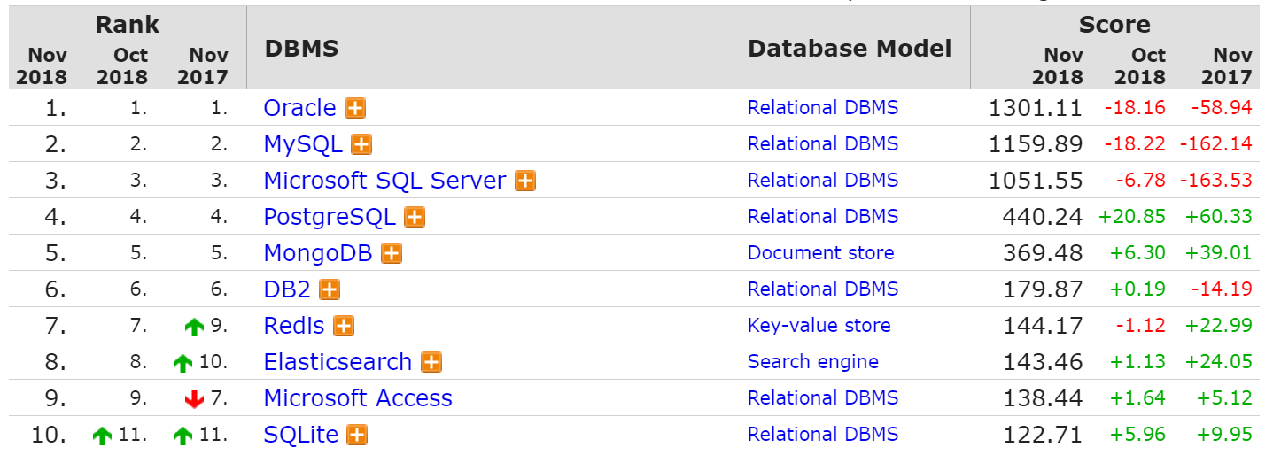
Common DBMS Systems
https://db-engines.com/en/ranking
Relational database management systems are widely used!

Slide 11
Relational Database Management Systems
Relational databases are the traditional DBMS technology
Logically organize data in relations (tables)
Describes relationship:
Name purchased Prod at Price.
Sales relation:
Name | Prod | Price
Sue | iPod | $200.00
Joey | Bike | $333.99
Alice | Car | $999.00
Tuple (row)
How is data physically stored?
Attribute (column)

Slide 12
Relational Data Abstraction
Database Management System
Relations (Tables)
Optimized Data Structures
Name | Prod | Price
Sue | iPod | $200.00
Joey | Bike | $333.99
Alice | Car | $999.00
B+Trees
sid | sname | rating | age
28 | yuppy | 9 | 35.0
31 | lubber | 8 | 55.5
44 | guppy | 5 | 35.0
58 | rusty | 10 | 35.0
Abstraction
Page 1
Page 2
Optimized Storage
bid | bname | color
101 | Interlake | blue
102 | Interlake | red
104 | Marine | red
103 | Clipper | green
Page 3
Page 4
Page Header
Page 5
Page 6

Slide 13
Relational Data Abstraction
Physical Data Independence:
Database management systems hide how data is stored from end user applications
→ System can optimize storage and computation without changing applications.
Database Management System
Relations (Tables)
Optimized Data Structures
Name | Prod | Price
Sue | iPod | $200.00
Joey | Bike | $333.99
Alice | Car | $999.00
B+Trees
sid | sname | rating | age
28 | yuppy | 9 | 35.0
31 | lubber | 8 | 55.5
44 | guppy | 5 | 35.0
58 | rusty | 10 | 35.0
Abstraction
Big Idea in Data Structures
Page 1
Page 2
Optimized Storage
bid | bname | color
101 | Interlake | blue
102 | Interlake | red
104 | Marine | red
103 | Clipper | green
Data Systems &
Computer Science
Page 3
Page 4
Page Header
Page 5
Page 6
It wasn’t always like this …

Slide 14
In a time long ago …

Slide 15
Before 1970’s databases were not routinely organized as tables.
Instead they exposed specialized data structures designed for specific applications.

Slide 16
Ted Codd and the Relational Model
[1969] Relational model: a mathematical abstraction of a database as sets
Independence of data from the physical properties of stage storage and representation
[1972] Relational Algebra & Calculus: a collection of operations and a way defining logical outcomes for data transformations
Algebra: beginning of technologies like Pandas
Calculus: the foundation of modern SQL
Edgar F. “Ted” Codd (1923 - 2003)
Turing Award 1981

Slide 17
Relational Database Management Systems
Traditionally DBMS referred to relational databases
Logically organize data in relations (tables)
Structured Query Language (SQL) to define, manipulate and compute on data.
A common language spoken by many data systems
Some variations and deviations from the standard …
Describes logical organization of data as well as computation on data.

Slide 18
SQL
What not How

Slide 19
SQL is a Declarative Language (Review)
Declarative: “Say what you want, not how to get it.”
Declarative Example: I want a table with columns “x” and “y” constructed from tables “A” and ”B” where the values in “y” are greater than 100.00.
Imperative Example: For each record in table “A” find the corresponding record in table “B” then drop the records where “y” is less than or equal to 100 then return the ”x” and “y” values.
Advantages of declarative programming
Enable the system to find the best way to achieve the result.
Often more compact and easier to learn for non-programmers
Challenges of declarative programming
System performance depends heavily on automatic optimization
Limited language (not Turing complete)

Slide 20
Relational Terminology
Database: Set of Relations (i.e., one or more tables)
Relation (Table):
Schema: description of columns, their types, and constraints
Instance: data satisfying the schema
Attribute (Column)
Tuple (Record, Row)
Schema of database is set of schemas of its relations

Slide 21
More on Relational Tables
Schema: description of columns, their types, and constraints
Each column has a:
Name
Type (one of a few primitive types)
Constraints:
Primary Key → Unique
Foreign Key → References a primary key in another table (must be present)
Boolean predicates (ex. gpa > 0.0 and gpa < 4.0)
Instance: A particular instantiation of a schema with data satisfying that schema.
a multiset of “rows” (“tuples”) (entries are not unique)
{(‘Bob Snob’, 3.3,’CS’), (‘Bob Snob’, 3.3,’CS’), (‘Mary Contrary’, 3.8, ‘CS’)}
In Codd’s original formulation instances were sets

Slide 22
Two sublanguages of SQL
DDL – Data Definition Language
Define and modify schema
DML – Data Manipulation Language
For interacting with the data itself
CAPITALIZATION IS optional BUT … DATABASE PEOPLE PREFER TO YELL
SELECT * FROM THINGS;

Slide 23
Creating Tables & Populating Tables

Slide 24
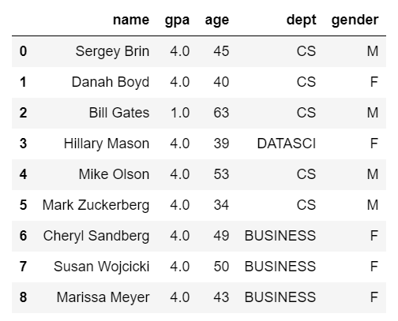
Creating Tables
CREATE TABLE students(
name TEXT PRIMARY KEY,
gpa REAL CHECK (gpa >= 0.0 and gpa <= 4.0),
age INTEGER,
dept TEXT,
gender CHAR);
Imposing Integrity Constraints
Useful to ensure data quality…

Slide 25
Inserting Records into a Table
INSERT INTO students
VALUES
('Sergey Brin', 2.8, 45, 'CS', 'M'),
('Danah Boyd', 3.9, 40, 'CS', 'F'),
('Bill Gates', 1.0, 63, 'CS', 'M'),
('Hillary Mason', 4.0, 39, 'DATASCI', 'F'),
('Mike Olson', 3.7, 53, 'CS', 'M'),
('Mark Zuckerberg', 3.8, 34, 'CS', 'M'),
('Cheryl Sandberg', 3.6, 49, 'BUSINESS', 'F'),
('Susan Wojcicki', 3.8, 50, 'BUSINESS', 'F'),
('Marissa Meyer', 2.6, 43, 'BUSINESS', 'F’)
-- This is a comment.
-- Does the order matter?
(name, gpa, age, dept, gender) ← Optional
Fields must be entered in order (record)
Comma between records
Must use the single quote (’) for strings.
No
http://sqlfiddle.com/#!9/120e17/1/0
Note: These GPA values are totally arbitrary.

Slide 26
Interacting with a DBMS in Pandas
In our course, we’ll almost always interact with a DBMS using Pandas.
Typical workflow:
Create SQLAlchemy Engine object.
Use pd.read_sql_query(query, engine) to perform queries.
Other workflows exist, examples:
Executing SQL queries directly using an Engine object.
Using the to_sql method for dataframes.
Let’s try out a quick demo.

Slide 27
Common SQL Types (there are others...)
CHAR(size): Fixed number of characters
TEXT: Arbitrary number of character strings
INTEGER & BIGINT: Integers of various sizes
REAL & DOUBLE PRECISION: Floating point numbers
DATE & DATETIME: Date and Date+Time formats
See documentation for database system (e.g., Postgres)

Slide 28
CREATE TABLE Sailors (
sid INTEGER,
sname CHAR(20),
rating INTEGER,
age REAL,
PRIMARY KEY (sid));
CREATE TABLE Boats (
bid INTEGER,
bname CHAR (20),
color CHAR(10),
PRIMARY KEY (bid));
CREATE TABLE Reserves (
sid INTEGER,
bid INTEGER,
day DATE,
PRIMARY KEY (sid, bid, day),
FOREIGN KEY (sid) REFERENCES Sailors,
FOREIGN KEY (bid) REFERENCES Boats);
Columns have names and types
sid | sname | rating | age
1 | Fred | 7 | 22
2 | Jim | 2 | 39
3 | Nancy | 8 | 27
Specify Primary Key column(s)
bid | bname | color
101 | Nina | red
102 | Pinta | blue
103 | Santa Maria | red
Specify Foreign Key relationships
sid | bid | day
1 | 102 | 9/12
2 | 102 | 9/13
Semicolon at end of command

Slide 29
Deleting and Modifying Records
Records are deleted by specifying a condition:
Modifying records
Note: There is no way to modify records by location
DELETE FROM students
WHERE LOWER(name) = 'sergey brin'
String Function
UPDATE students
SET gpa = 1.0 + gpa
WHERE dept = ‘CS’;

Slide 30
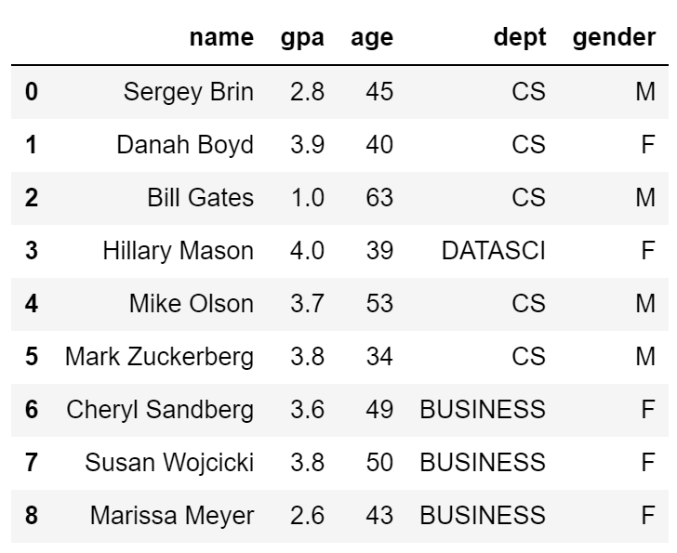
Deleting and Modifying Records
What is wrong with the following
UPDATE students
SET gpa = 1.0 + gpa
WHERE dept = ‘CS’;
CREATE TABLE students(
name TEXT PRIMARY KEY,
gpa FLOAT CHECK (gpa >= 0.0 and gpa <= 4.0),
age INTEGER,
dept TEXT,
gender CHAR);
Update would violate Integrity Constraints

Slide 31
Dropping Tables
To delete a table entirely from our database, we can use the “DROP TABLES” command.
Example: DROP TABLE tips;
Be careful, there is no easy way to undo this command.

Slide 32
Querying Tables

Slide 33
SQL DML: Basic Single-Table Queries
SELECT [DISTINCT] <column expression list> FROM <single table> [WHERE <predicate>] [GROUP BY <column list> [HAVING <predicate>] ] [ORDER BY <column list>];
Elements of the basic select statement
[Square brackets] are optional expressions.

Slide 34
Basic Single-Table Queries
SELECT [DISTINCT] <column expression list> FROM <single table> [WHERE <predicate>] [GROUP BY <column list> [HAVING <predicate>] ] [ORDER BY <column list>] ;
Simplest version is straightforward
Produce all tuples in the table that satisfy the predicate
Output the expressions in the SELECT list
Expression can be a column reference, or an arithmetic expression over column refs

Slide 35
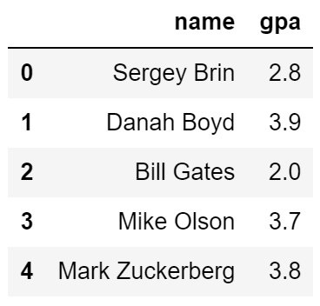
Find the name and GPA for all CS Students
SELECT name, gpa FROM students WHERE dept = 'CS'

Slide 36
Find the name and GPA for all CS Students
SELECT name, gpa FROM students WHERE dept = 'CS'

Slide 37
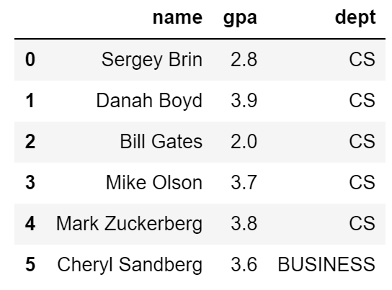
Combing predicates with OR and AND
SELECT name, gpa FROM students WHERE dept = 'CS’ OR name < ‘B’

Slide 38
Doing Math In SELECT statement
SELECT log(1000) as three,
exp(ln(2)) as two,
cos(0) as one,
ln(2*3) = ln(2) + ln(3) as sanity;
http://sqlfiddle.com/#!17/121b8/17

Slide 39
String Comparisons
SELECT sname
FROM Sailors
WHERE sname LIKE 'B_%'
Old-school SQL
http://sqlfiddle.com/#!17/53815/7
SELECT sname
FROM Sailors
WHERE sname ~ 'B.*'
Standard Regular Expressions
http://sqlfiddle.com/#!17/53815/8

Slide 40
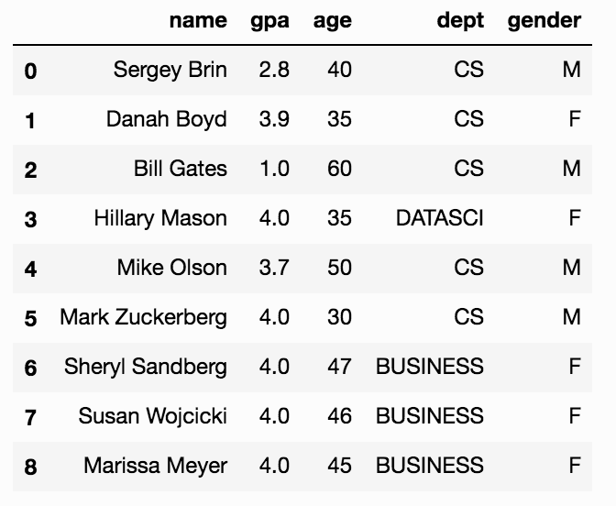
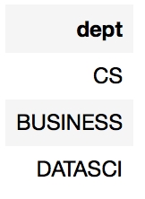
SELECT DISTINCT
SELECT DISTINCT dept FROM students [WHERE <predicate>] [GROUP BY <column list> [HAVING <predicate>] ] [ORDER BY <column list>] ;
DISTINCT flag specifies removal of duplicates before output

Slide 41
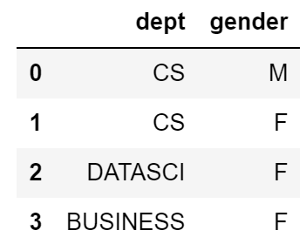
SELECT DISTINCT
SELECT DISTINCT dept, gender FROM students [WHERE <predicate>] [GROUP BY <column list> [HAVING <predicate>] ] [ORDER BY <column list>] ;
DISTINCT flag specifies removal of duplicates before output
DISTINCT operates at the tuple level, not the column level

Slide 42
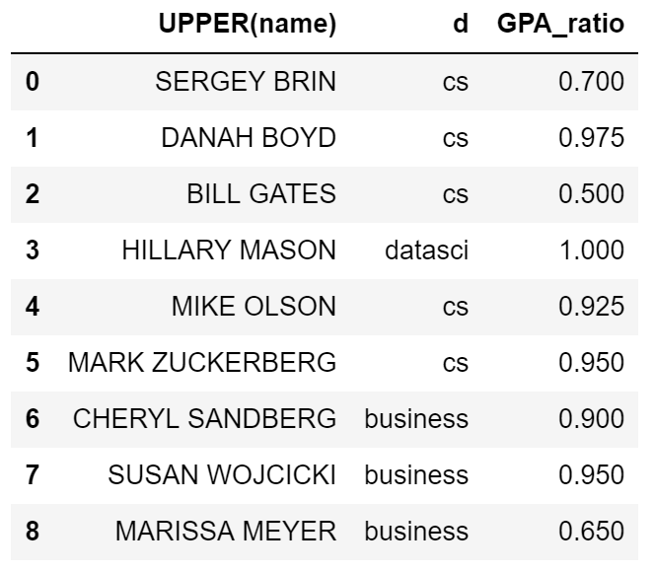
Functions in the SELECT list
SELECT UPPER(name), LOWER(dept) AS d, gpa/4.0 AS GPA_ratio FROM students [WHERE <predicate>] [GROUP BY <column list> [HAVING <predicate>] ] [ORDER BY <column list>] ;
Can provide functions in selection list.
AS lets us alias (name) our columns.

Slide 43
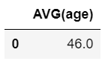
Aggregates
SELECT AVG(age) FROM students WHERE dept = 'CS' [GROUP BY <column list> [HAVING <predicate>] ] [ORDER BY <column list>] ;
Before producing output, compute a summary statistic
Aggregates include: SUM, COUNT, MAX, MIN, …
Produces 1 row of output → Still a table
Note: can use DISTINCT inside the agg function
SELECT COUNT(DISTINCT name) …

Slide 44
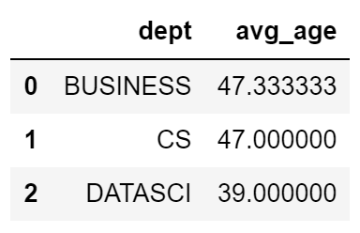
GROUP BY
SELECT dept, AVG(age) FROM students [WHERE <predicate>] GROUP BY dept [HAVING <predicate>] [ORDER BY <column list>] ;
Partition table into groups with same GROUP BY column values
Group By takes a list of columns
Produce an aggregate result per group
Notes:
SELECT list can contain aggs and GROUP BY columns only!
What would it mean if we said SELECT name, AVG(gpa) above??

Slide 45
What does the following Produce?
SELECT name, AVG(age) FROM students [WHERE <predicate>] GROUP BY dept [HAVING <predicate>] [ORDER BY <column list>] ;
An error! (why?)
What name should be used for each group?
Notes:
This doesn’t yield an error in SQLite or in sqlfiddle so I’m hiding this slide.

Slide 46
What if we wanted to only consider departments that have greater than two students?
SELECT dept, AVG(age) FROM students [WHERE <predicate>] GROUP BY dept [HAVING <predicate>] [ORDER BY <column list>] ;

Slide 47
What if we wanted to only consider departments that have greater than two students?
SELECT dept, AVG(age) FROM students WHERE COUNT(*) > 2 GROUP BY dept [HAVING <predicate>] [ORDER BY <column list>] ;
?
Doesn’t work …
WHERE clause is applied before GROUP BY
You cannot have aggregation functions in the where clause

Slide 48
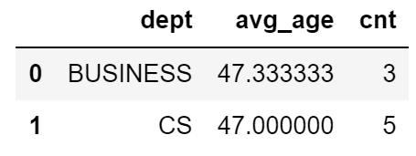
HAVING
SELECT dept, AVG(gpa) as avg_age, COUNT(*) as cnt FROM students [WHERE <predicate>] GROUP BY dept HAVING COUNT(*) > 2 [ORDER BY <column list>] ;
The HAVING predicate is applied after grouping and aggregation
Hence can contain anything that could go in the SELECT list
HAVING can only be used in aggregate queries

Slide 49
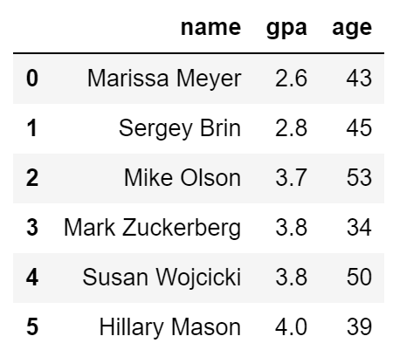
ORDER BY
SELECT name, gpa, age FROM students WHERE name > ‘E' [GROUP BY <column list> [HAVING <predicate>] ] ORDER BY gpa, name;
ORDER BY clause specifies output to be sorted
Lexicographic ordering

Slide 50
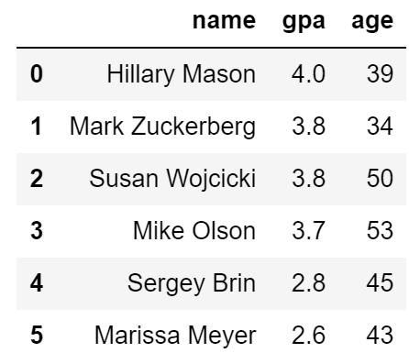
ORDER BY
SELECT name, gpa, age FROM students WHERE name > ‘E' [GROUP BY <column list> [HAVING <predicate>] ] ORDER BY gpa DESC, name ASC;
Ascending order by default
DESC flag for descending, ASC for ascending
Can mix and match, lexicographically

Slide 51
Conceptual SQL Evaluation
SELECT [DISTINCT] target-list
FROM relation-list
WHERE qualification
GROUP BY grouping-list
HAVING group-qualification
Try Queries Here
http://sqlfiddle.com/#!17/67109/12
Form groups & aggregate
GROUP BY
[DISTINCT]
Eliminate duplicates
Project away columns
(just keep those used in SELECT, GBY, HAVING)
Apply selections
(eliminate rows)
WHERE
SELECT
One or more tables to use
(cross product …)
Eliminate groups
FROM
HAVING

Slide 52
LIMIT
SELECT [DISTINCT] <column expression list> FROM <single table> [WHERE <predicate>] [GROUP BY <column list> [HAVING <predicate>] ] [ORDER BY <column list>] [LIMIT <number>];
The LIMIT clause lets us specify the maximum number of results to return. Similar to head().
Does not return a random sample!

Slide 53
Test Your Understanding #1
SELECT dept, AVG(gpa) AS avg_gpa, COUNT(*) AS size FROM students WHERE gender = 'F' GROUP BY dept HAVING COUNT(*) > 2 ORDER BY avg_gpa DESC
What does this compute?
GROUP BY
[DISTINCT]
WHERE
SELECT
FROM
HAVING
yellkey.com/TBA

Slide 54
Test Your Understanding #1
SELECT dept, AVG(gpa) AS avg_gpa, COUNT(*) AS size FROM students WHERE gender = 'F' GROUP BY dept HAVING COUNT(*) > 2 ORDER BY avg_gpa DESC
What does this compute?
The average GPA of female students and number of female students in each department where there are at least 3 female students in that department. The results are ordered by the average GPA.
GROUP BY
[DISTINCT]
WHERE
SELECT
FROM
HAVING

Slide 55
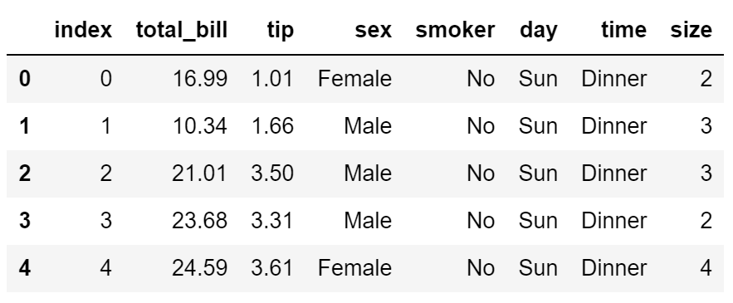
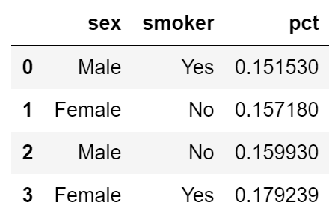
Test Your Understanding #2
SELECT ???? FROM tips WHERE ???? GROUP BY ???? HAVING ???? ORDER BY ????
Suppose we want to compare smoker vs. non-smoker and female vs. male tips for weekend diners. Create a table ordered by percentage tip that gives the average tip for all four possibilities.

Slide 56
Test Your Understanding #2
SELECT sex, smoker, avg(tip/total_bill) as pct FROM tips WHERE day = 'Sun' OR day = 'Sat' GROUP BY sex, smoker HAVING ORDER BY pct
Suppose we want to compare smoker vs. non-smoker and female vs. male tips for weekend diners. Create a table ordered by percentage tip that gives the average tip for all four possibilities.

Slide 57
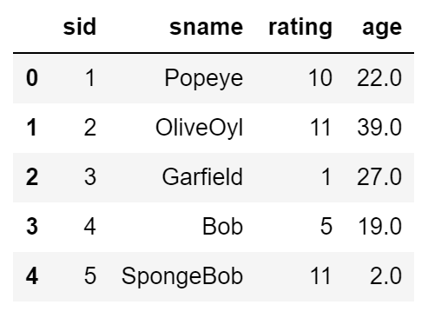
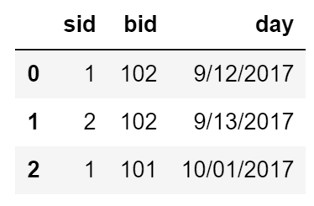
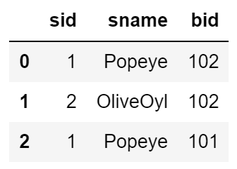
Basic Joins
SELECT s.sid, s.sname, r.bid
FROM Sailors s, Reserves r
WHERE s.sid = r.sid
AND s.age > 20;
Can select from multiple tables.
By ensuring sids are equal we get an inner join.
Will discuss joins in more detail in the next lecture.
http://sqlfiddle.com/#!17/4215a/10

Slide 58
How do you interact with a database?
What is the DBMS?
Server
Software
A library
Answer: It can be all of these.

Slide 59
Interacting with a DBMS
Query
SELECT * FROM sales
WHERE price > 100.0
DBMS Server on
your own machine
Python Analysis
Response
Date | Purchase ID | Name | Price
9/20/2012 | 1234 | Sue | $200.00
8/21/2012 | 3453 | Joe | $333.99

Slide 60
Interacting with a DBMS
Cust.
Prod.
Sales
Query
SELECT * FROM sales
WHERE price > 100.0
DBMS Server
Python Analysis
Response
Date | Purchase ID | Name | Price
9/20/2012 | 1234 | Sue | $200.00
8/21/2012 | 3453 | Joe | $333.99

Slide 61

Interacting with a DBMS
Cust.
Prod.
Sales
Web Servers
DBMS Server
HTTP
Web Applications
Often many systems will connect to a DBMS concurrently.
Python Analysis
Visualization

Slide 62
Why are databases drawn as “cans”

Slide 63
Platters on a Disk Drive
Looks Like?

Slide 64

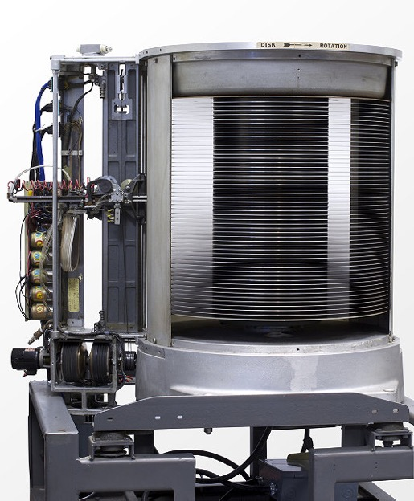
Platters on a Disk Drive
Looks Like?
1956: IBM MODEL 350 RAMAC
First Commercial Disk Drive
5MB @ 1 ton

